Slide 1
(NBAC TSC Annual Meeting)
18 August 2022
Kamran Atri
Thomas Krul

Slide 2
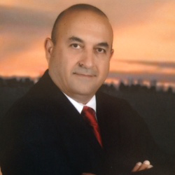
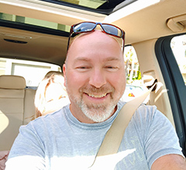
Welcome to the 2022 Nbac TSC Annual meeting
Welcome
Admin
GTRI Facilities
MS TEAMS
Meeting Etiquette
Agenda
Opening Remarks
Kamran Atri
NIEM Business Architecture Committee Co-Chair
CEO A4SAFE INC
Thomas Krul
NIEM Business Architecture Committee Co-Chair
Enterprise Architect at Department of National Defence Ottawa, Ontario, Canada

Slide 3

MS TEamS
Microsoft Teams meeting
Join on your computer or mobile app
Click here to join the meeting
https://dod.teams.microsoft.us/l/meetup-join/19%3adod%3ameeting_aaa3877ce06b43c4846d2ba47d336309%40thread.v2/0?context=%7b%22Tid%22%3a%22102d0191-eeae-4761-b1cb-1a83e86ef445%22%2c%22Oid%22%3a%2209533073-ba80-4ec6-aa29-c3f724b8aa56%22%7d
Or call in (audio only)
+1 410-874-6749,,579640852# United States, Baltimore
Phone Conference ID: 579 640 852# Find a local number | Reset PIN
Document Repo: https://github.com/NIEM/NIEM-Annual-Meetings/tree/master/2022 < Caution-https://github.com/NIEM/NIEM-Annual-Meetings/tree/master/2022

Slide 4
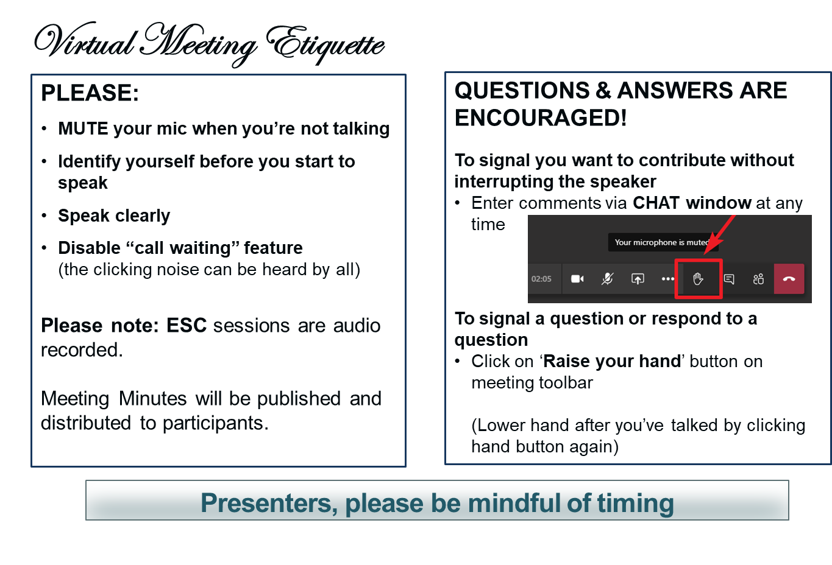
Making the most of our session

Slide 5
Agenda

Slide 6
Agenda (cont.)

Slide 7
Opening remarks
NIEM / NBAC Annual meeting – history and purpose
Distinguished guests and speakers
Organizers and facilitators appreciation
Main topic – NIEM transition to NIEM Open
Learning from one another and spend time networking
The day of togetherness and interaction

Slide 8
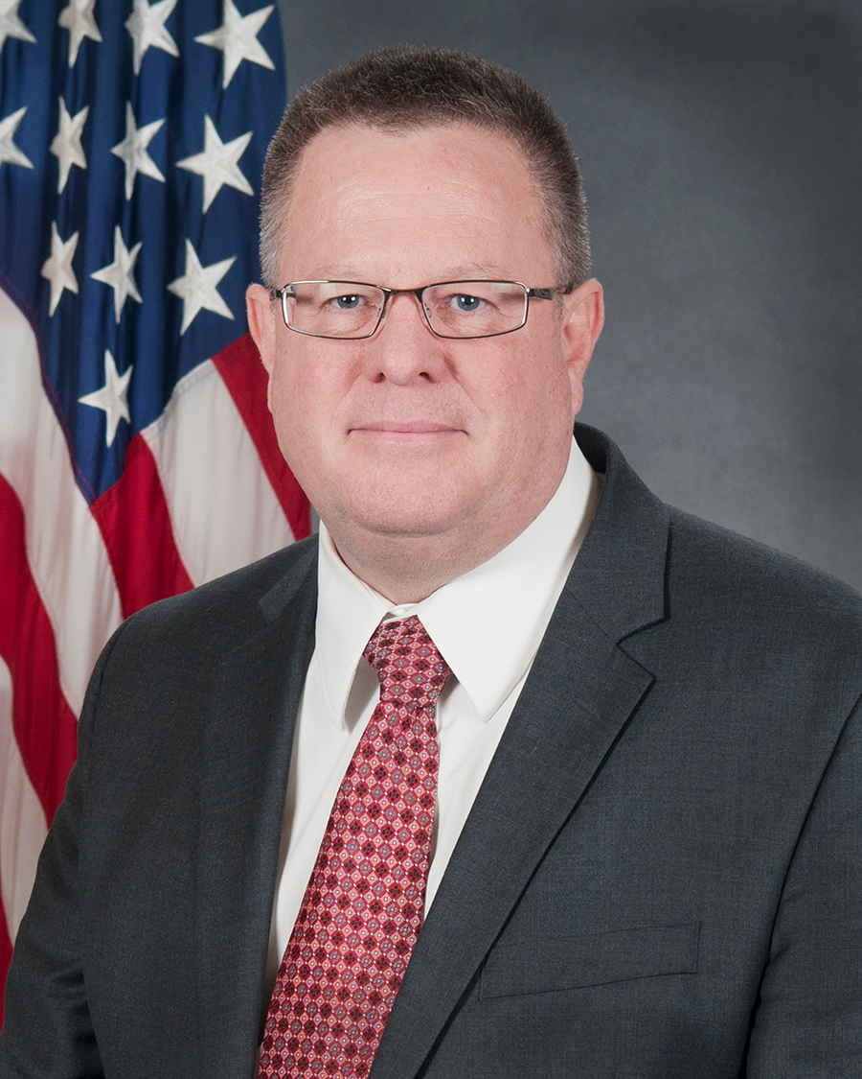
Guest Speaker
Introduction: Mr. Kamran Atri
Speaker: Mr. Ryan Schultz
Chief, Data and Standards Division
Joint Staff J6

Slide 9
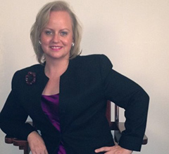
Guest Speaker
Introduction: Mr. Thomas Krul
Speaker: Ms. Katherine Escobar
Managing Director, NIEM
Deputy Division Chief Data and Standards Division
Joint Staff J6

Slide 10
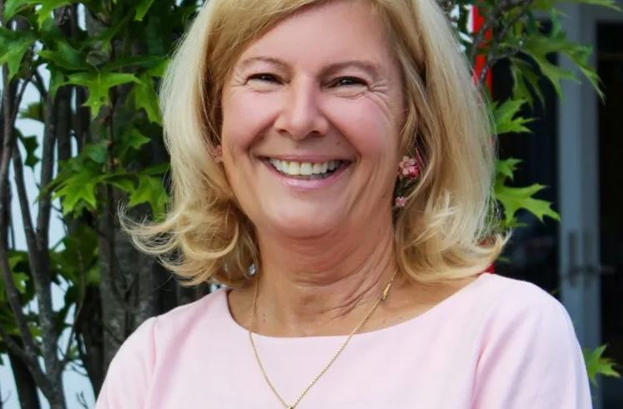

Guest Speaker
Introduction: Ms. Katherine Escobar
Speakers: Ms. Dee Schur & Mr. Chet Ensign
OASIS OPEN Senior Manager, Development & Advocacy
OASIS OPEN Senior Manager, Development & Advocacy

Slide 11
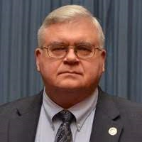
keynote Speaker
Introduction: Mr. Kamran Atri
Keynote Speaker: Mr. Philip Mattson
Philip Mattson serves in the DHS Science and Technology Directorate as the DHS Standards Executive and Senior Standards Advisor. He represents DHS on the Interagency Committee on Standards Policy and serves on several ANSI and ASTM committees and other standards related forums.
Mr. Mattson has a bachelor’s degree in Nuclear Engineering Technology from Oregon State University, and a master’s in Nuclear Physics from the Naval Postgraduate School and is a registered Professional Engineer.
Mr. Mattson is a retired U.S. Army officer, having served as a combat engineer and nuclear physicist.
Senior Standards Advisor and DHS Standards Executive
Systems Engineering & Standards Division
Science and Technology Directorate
US Department of Homeland Security

Slide 12
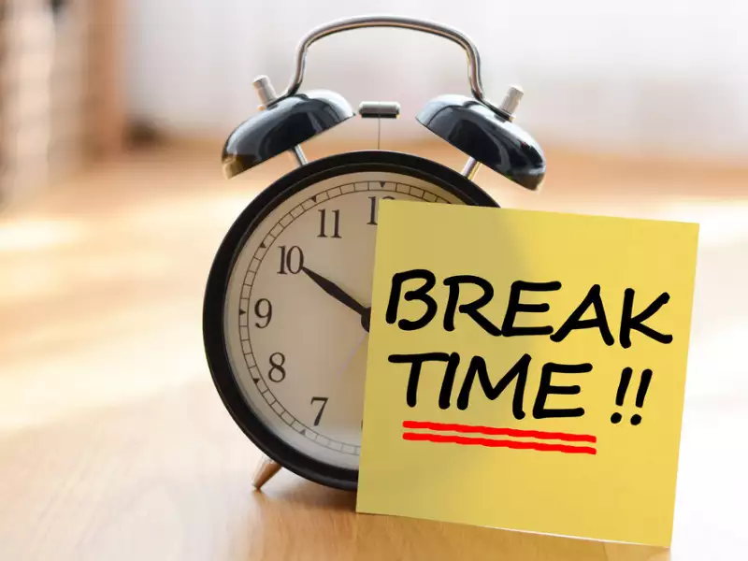
break
10 Minutes

Slide 13
Agenda (cont.)

Slide 14
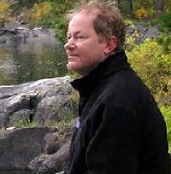
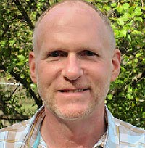
NTAC Annual MEETING Out-brief
Introduction: Mr. Kamran Atri
Speakers: Dr. Scott Renner & Mr. Mike Hulme
NIEM Technical Architecture Committee Co-Chair, principal engineer at The MITRE Corporation
NIEM Technical Architecture Committee Co-Chair, Enterprise/Solutions Architect for Unisys Corporation

Slide 15

Guest speaker
Introduction: Mr. Thomas Krul
Speaker: Major Scott Widener
Canadian Armed Forces
Department of National Defence / Government of Canada

Slide 16
(Assessments)
18 August 2022
Thomas Krul

Slide 17
Roundtable –NIEM Assessments
Mr. Thomas Krul Facilitator
How do we assess the maturity, vitality, and health of domains and NIEM overall
Survey Techniques
Metrics
Self Assessments

Slide 18
Roundtable – NIEM Assessments
Mr. Thomas Krul Facilitator
What do we mean by NIEM Assessments?
Maturity, vitality, and health of domains (and NIEM overall)
In what way do we measure these qualities?
Participation (NBAC, NTAC, additions to the model)
Accomplishments
Use within the community
Outreach
Other metrics?

Slide 19
Roundtable – NIEM Assessments
Mr. Thomas Krul Facilitator
How do we gather the data and assess?
Surveys
Self Assessments
Examine what data we have:
Git participation
Model growth/modifications
NBAC/NTAC participation
Relevancy to community/adoption rates

Slide 20
Roundtable – NIEM Assessments
Mr. Thomas Krul Facilitator
BACK-UP
Metrics & Indicators

Slide 21
Qualitative and Quantitative metrics & indicators - Examples
Outreach
Training Participation
Web Analytics
Release Overview/Stats
USMTF

Slide 22







State, Local , Tribal & Territorial (SLTT) Tiger Team “outreach”
2022 Accomplishments:
DAMA Briefings
DAMA Chicago Chapter (1/4/22)
DAMA Michigan Chapter (2/16/22)
DAMA Calgary (3/17/22)
DAMA Portland Chapter (5/19/22)
DAMA – DMBOK (Data Management Body of Knowledge)
Working with DAMA International
to incorporate a section addressing
NIEM
Arizona Criminal Justice Commission Presentation (4/18/22)
Utility Analytics Institute (UAI) Presentation (4/21/22)
2022 Accomplishments (cont.):
Nation Science Foundation Open Knowledge Network (OKN)
Developed Use Cases
NIEM Ontology
Decarceration
Mutual Aid
Family Unification
Criminal Justice Enterprise Tracking
Continue OKN Sprint (MAR-JUN 22)
Prep for NSF Solicitation
Other Outreach
SIEMENS Calgary
Kantara (Identity Assurance)
NIEM Open Sponsorship
SLTT collaboration with OASIS to
Identify and solicit NIEM Open sponsors

Slide 23





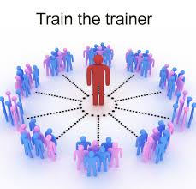
NIEM TRAINING – 2022 Activities
Revamp of Prior Training Programs
Older materials updated
JSON material added
Entire program reorganized
Follows the Message Specification (formerly IEPD) creation process
Attendees learn technical concepts in the context where they apply
Virtual Instructor Lead Sessions (SEP 21, NOV 21, JAN 22, FEB 22, MAR 22, APR 22, MAY 22, JUN 22)
Formally rolled out a ‘HYRBID’ model of technical training in July 2022
Videos available 24/7 at https://niem.gov/learn
Features 11 training videos; self-paced over 3-day
Instructor available for Q&A via MS Teams chat
Updated NIEM Survey to collect feedback based on new class format
Piloted “Ask-the-Expert” Live Q&A May pilot
FUTURE
Host Commercially - online training providers
LinkedIn
Coursera
Skillsoft
Build Instructional Pool
Formalize materials
Train-the-Trainer sessions
Commercial Provider

Slide 24
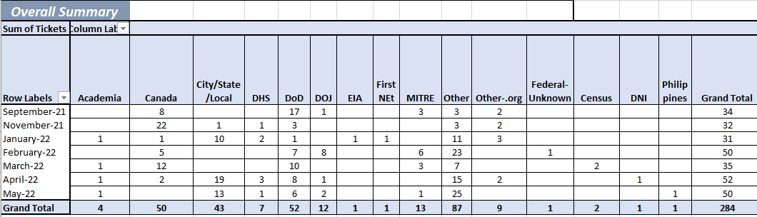
NIEM TRAINING analytics
Student Participation Totals
September 21 = 34
November 21 = 32
January 22 = 31
February 22 = 50
March 22 = 35
April 22 = 52
May 22 = 50
Demographics
Cont.
June 22 = 39
July 22** = 39
**Initial ‘HYRBID’ class format.
Next Class – August 2022 (TBD)

Slide 25
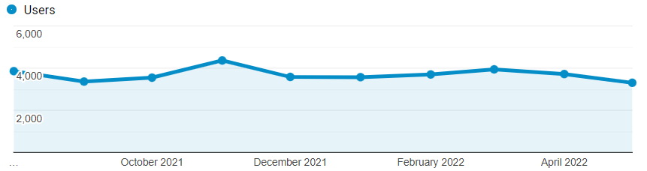
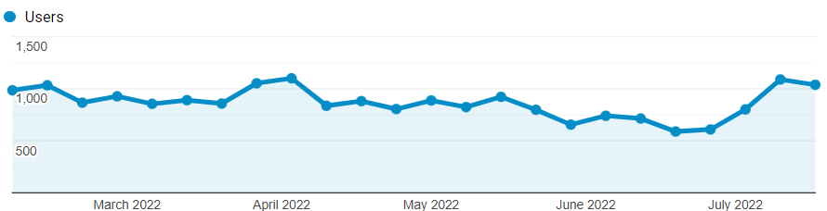
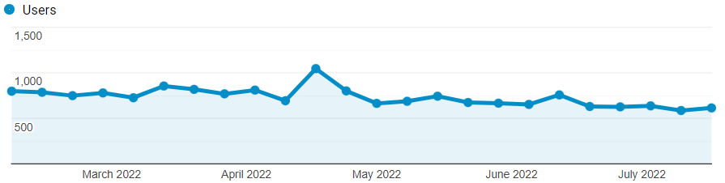
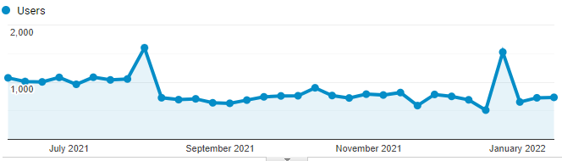
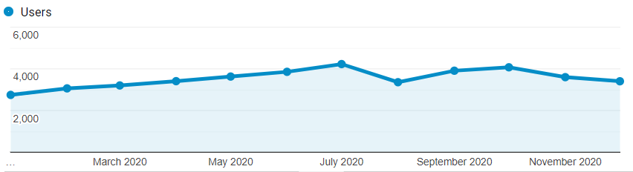
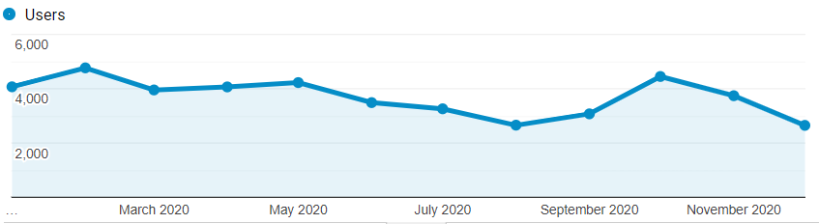
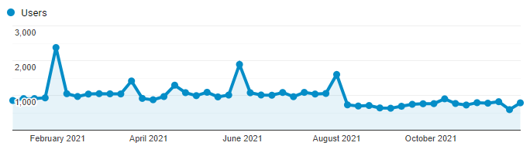
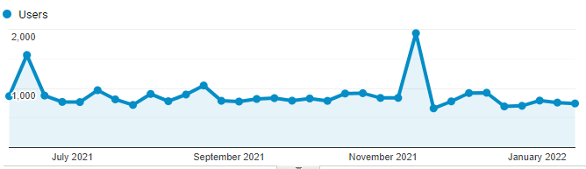
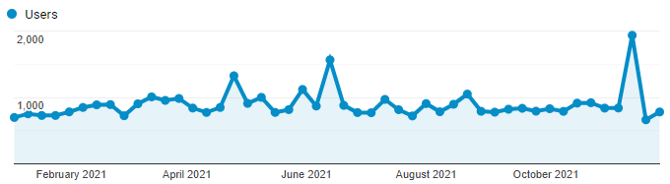
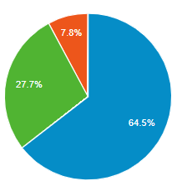
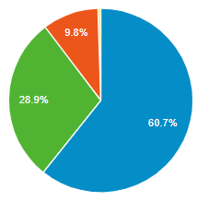
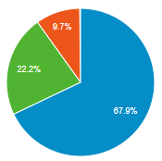
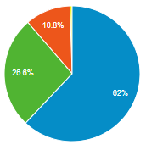
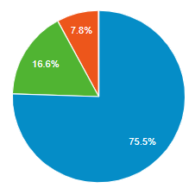
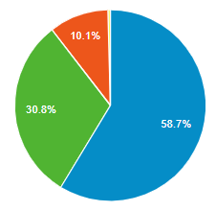
NIEM WEB ANALYTICS Year-to-date Overview
(Numbers/Arrows reflect changes between 02/01/22 – 07/23/22)
NIEM.gov (Informational)
NIEM.GitHub.io (Technical)
How is traffic over time?
How is traffic over time?
+5.4%
-2.8%
How are users finding NIEM?
What content do users view?
How are users finding NIEM?
What content do users view?
Top 5 Pages
/ (home page)
/about-niem
/about-niem/niem-model
/tools-catalog
/getting-started
Top 5 Pages
/niem-releases
/reference/[…]/attribute/json
/ (home page)
/json/sample-schema
/training
Direct
Organic
Referral
Direct
Organic
Referral
Social Media
Email Marketing
Why use email?
Users sign up & give permission to receive news
Personal & private; target users based on agency, role, etc.
Measureable analytics; email open rate, click through, etc.
33,219
Views
2,830 Followers
3,097
Members
7,359 Subscribers
+1257
+7
+28
+201
*Mailing list is routinely updated.

Slide 26
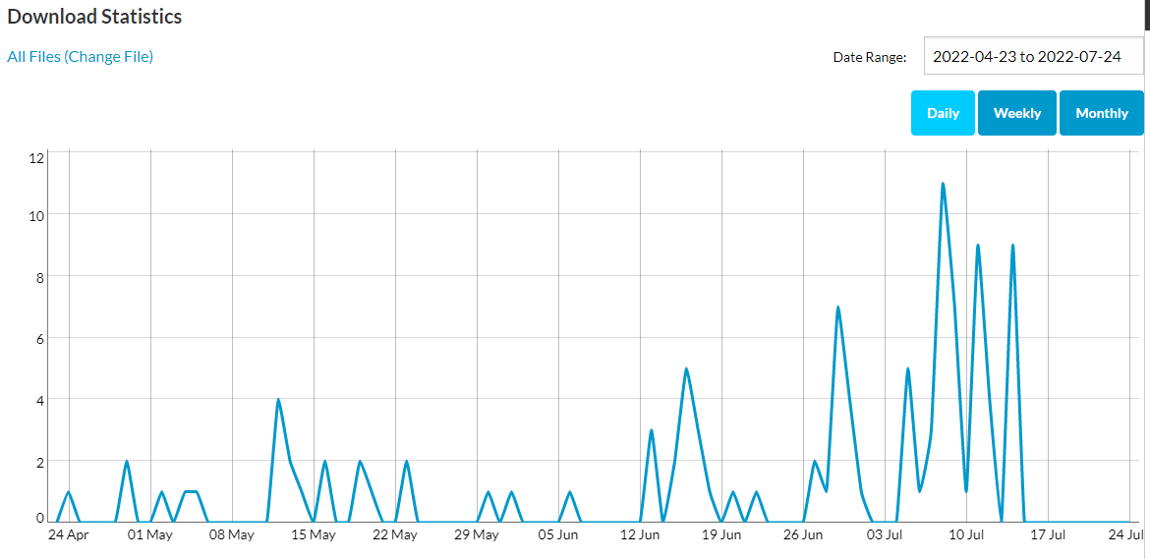
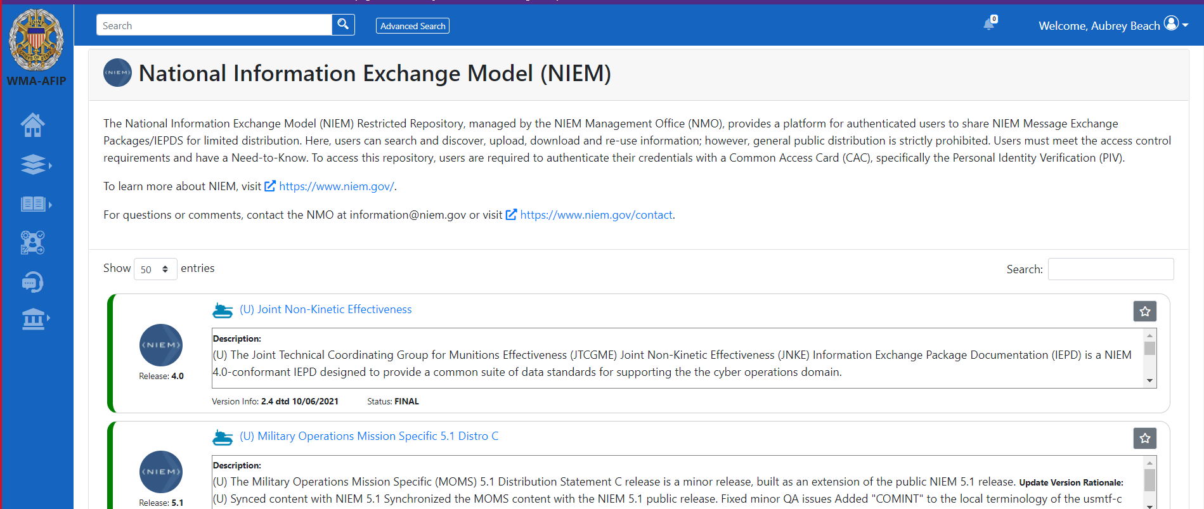
MEP Builder & r2 HIGHLIGHTS
MEP Builder
Total 104 downloads between April-Jul 2022
Available on Source Forge and directly on NIEM.gov
Demoed during NIEM Technical Trainings for June/July ‘22
Restricted Registry & Repository
Launched for DoD in May ‘22
4 Approved IEPDs / Message Specifications
70+ User Views
Most Viewed:
Joint Non-Kinetic Effectiveness (JNKE)

Slide 27
NIEM 5.1 Recap
Biometrics – Added new DNA and pedigree content
CUI – Refactored Limited Dissemination Control codes
Cyber (new) – Added content supporting federal and SLTT cyber incident reporting requirements
Emergency Management – Added flood damage claim content from OpenFEMA
Justice – Refactored and updated National Crime Information Center (NCIC) content
Military Operations – Added cyber-related content from the Joint Non-Kinetic Effectiveness (JNKE) IEPD
31

Slide 28
NIEM 5.2 Plans
Cyber
Adding Cyber Physical System (CPS) content
Learning and Development (new domain)
Adding content about courses, learning experiences, students, and positions
Military Operations
Adding USMTF content about military operations, missions, resources, readiness, and training
Adding Minimum Essential Metadata
International Human Services (new domain) – deferred to NIEM 6.0
33

Slide 29
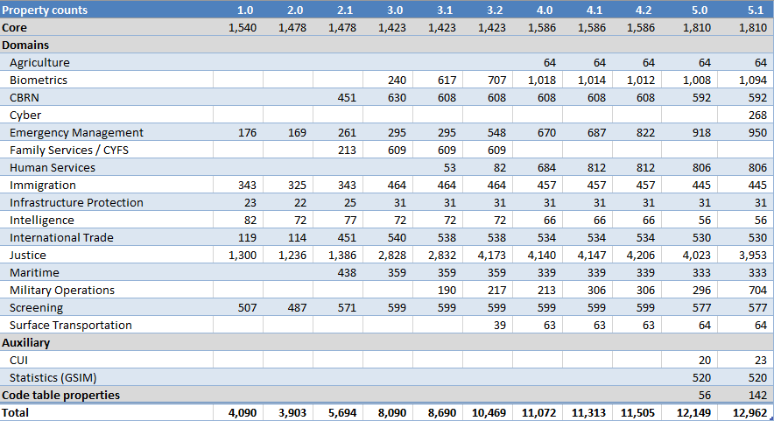
Release Statistics (property counts/details)

Slide 30
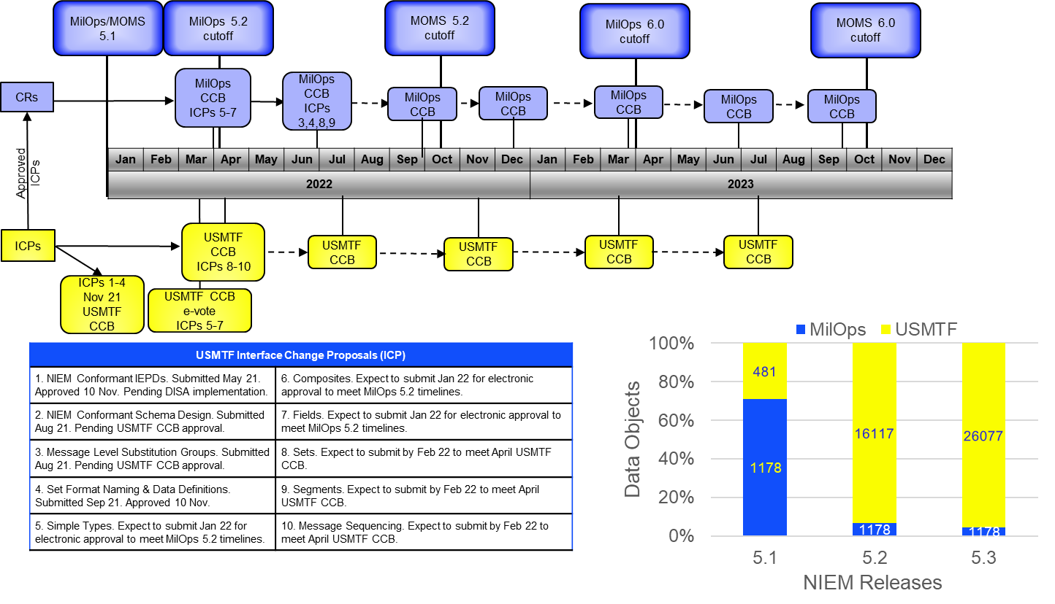
USMTF contribution to MilOps NIEM Model (5.1 actual, 5.2 & 5.3 Planned)
CR=MilOps change request
ICP=USMTF interface change proposal
MOMS=MilOps Mission Specific (restricted content)
- - - - > = if needed

Slide 31

break
1 Hour, Return 1 PM

Slide 32
Welcome BACK to the 2022 Nbac Annual meeting
Afternoon Session
Opening Remarks
Agenda

Slide 33
agenda

Slide 34
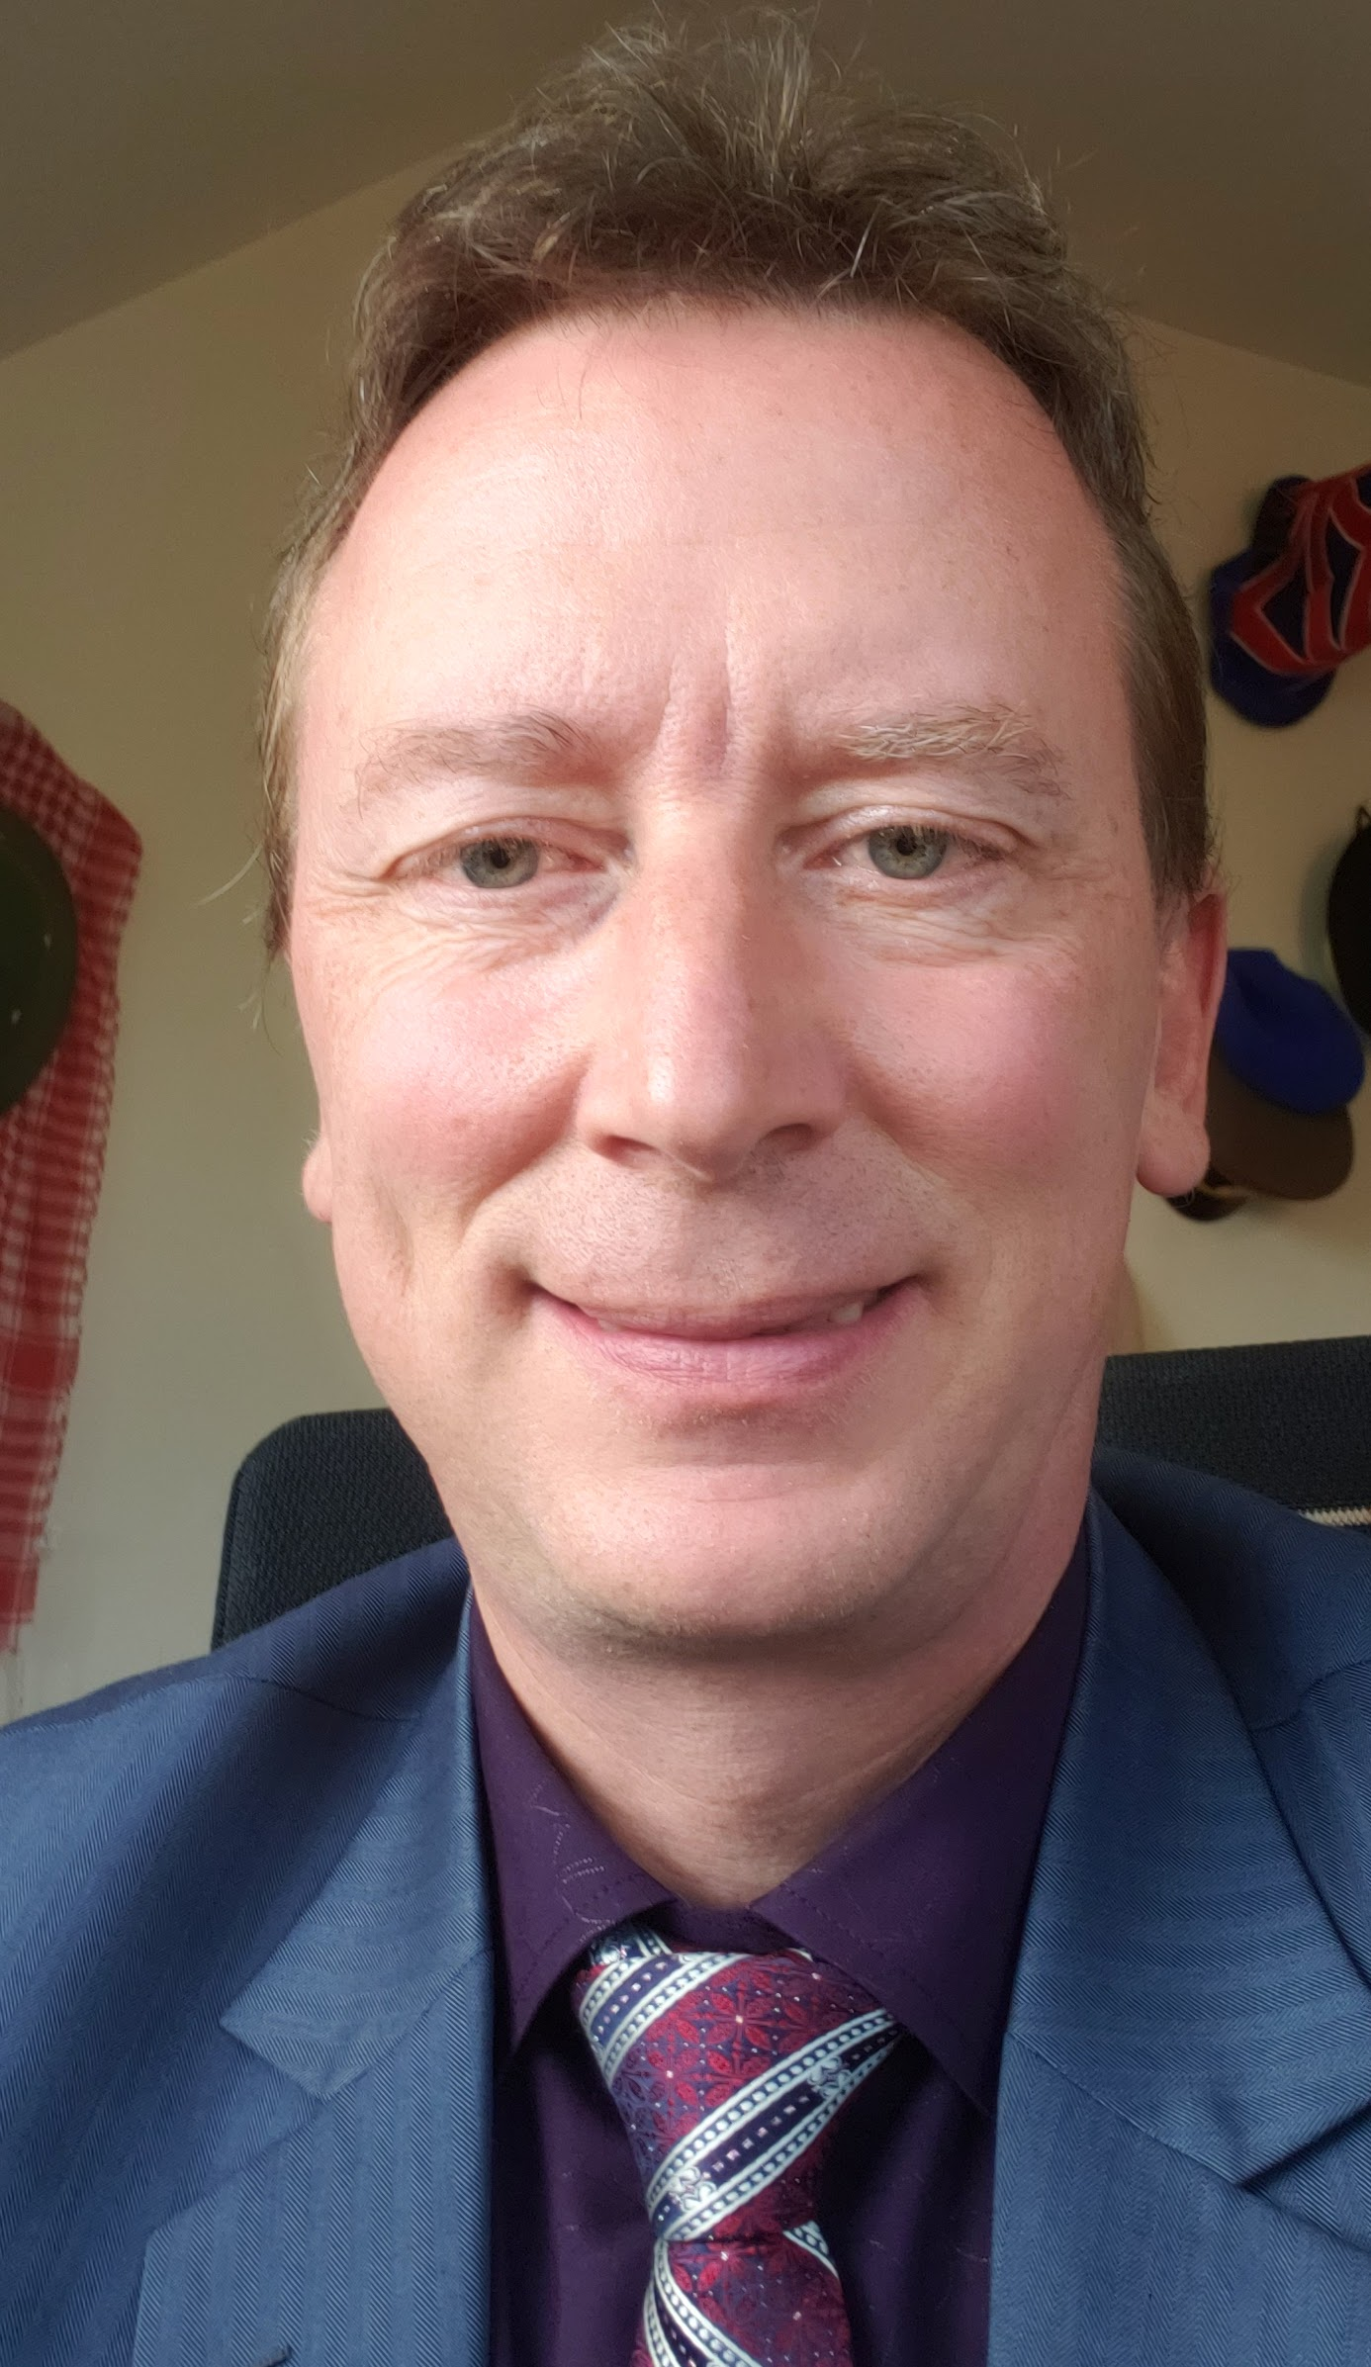
Guest speaker – International perspective
Introduction: Mr. Thomas Krul
Speaker: Mr. Michel Savoie
Director, Interoperability Solutions
Information, Innovation and Technology Branch
Employment and Social Development Canada / Government of Canada

Slide 35
Roundtable
Mr. Kamran Atri, Mr. Thomas Krul, & Mr. Chet Ensign Facilitators
Governance Documents – Mr. Kamran Atri
NIEM OPEN NBAC TSC Governance
NIEM OPEN Instantiating a Domain
NIEM OPEN Release Process - Mr. Kamran Atri/ Mr. Chet Ensign

Slide 36

NIEM OPEN NBAC TSC Governance
Formally NBAC Charter

Slide 37
OASIS Technical steering committee (TSC)
The Project Governance Board (PGB) shall form a Technical Steering Committee (TSC) by a resolution of the PGB. A Project’s TSC members shall be composed of the persons and chaired by such person as is provided by that resolution. The PGB must create, outline requirements for joining and voting, publish process documentation for each TSC, consistent with these Rules (including Section 10), and shall specify whether the Chair(s) of the TSC are selected by the PGB, or by that TSC’s members.
The TSC shall have the duties to advise the PGB and such others as are specified by the PGB, so long as consistent with these Rules and OASIS policies.
The following activities may not be delegated by the PGB to TSC : election or termination of PGB Chairs, approval of any Releases, Group Releases, Project Specification Drafts, Project Specifications, and approval of Candidates for OASIS Standards or external submissions.
TSC members must have signed and submitted an individual Contributor License Agreements (CLA), and if appointed by an entity, that entity must sign an entity CLA. A list of TSC members shall be maintained and posted at the general information web page designated by OASIS for the Project. An individual may resign from TSC membership at any time, by notifying the Open Project Administrator and the Chair(s) in writing.
Reference - https://www.oasis-open.org/policies-guidelines/open-projects-process/#chairs-maintainers-technical-steering-committees

Slide 38
NBAC TSC
Scope
Coordinate, harmonize and unify NIEM Domain’s content as it relates to the NIEM data model and the code-list
Safeguard NIEM data model core content
Identify, validate and on-board new NIEM domains
Advise, and support the PGB on matters relating to business architecture and requirements of NIEM.
Responsibilities
Facilitate construction, maintenance, and use of a business architecture framework, model, code, and other NIEM related documentations
Manage the harmonization process
Develop & package release candidates
Manage the NIEM Core
Serve as forum for NIEM Domains
Establish tiger teams and subcommittees
Onboard new domains, vet new data model content
Provide training
Shephard release candidate through PGB evaluation & acceptance
Assess NIEM domain maturity, vitality, & health

Slide 39
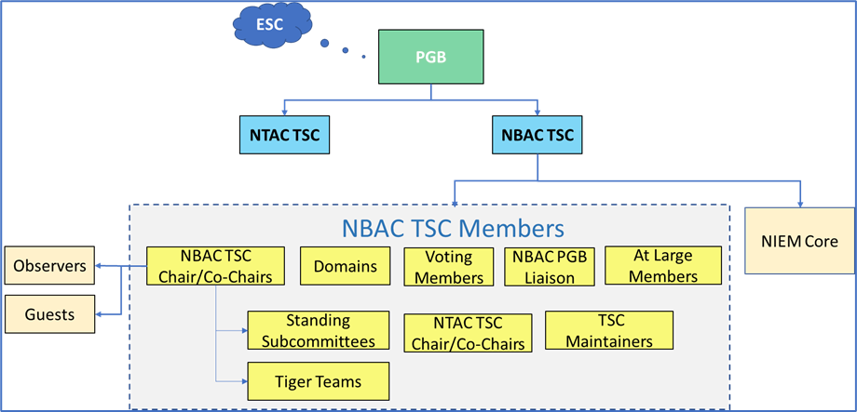
NBAC TSC
Membership
NBAC Chair/Co-Chairs
Domain Stewards
Domains
Voting Members
NTAC Co-Chairs
TSC Maintainers
NBAC PGB Liaison
At-Large Members
Tiger Teams
Subcommittees

Slide 40
NBAC TSC Members
At Large Members – NIEM stakeholders/Communities of Interest (CoI) unaffiliated with a specific domain may participate as At-Large members. Members need not be aligned to a formal domain to create NIEM exchanges or participate in the NBAC TSC.
TSC Liaison - The NBAC TSC Liaison to the PGB is appointed by the NBAC TSC co-chairs with consent of the PGB. Nominees can be submitted by any individual. The NBAC TSC Liaison serves a nominal 2-year renewable term at the discretion of the NBAC co-chairs.
TSC Maintainer - When a NBAC TSC Maintainer (hereafter referred to as NBAC Maintainer) is appointed to manage a NBAC GitHub repository, that Maintainer may serve in the dual role as TSC Liaison.
The NBAC voting members include:
NBAC Co-chairs
Domains are allowed two voting members appointed by the domain steward or as specified in a domain charter.

Slide 41
Domain Steward responsibilities
Appoint domain voting members (2 maximum)
Understand OASIS rules and NIEM Open governance
Maintain a data dictionary
Maintain a domain roster and mailing list
Perform outreach to domain CoI stakeholders
Draft, publish, and maintain procedures for domain governance and processes related to domain data model and code list release management
Participate in domain content harmonization
Provide domain support to the NBAC TSC including annual reporting of progress, plans, requirements, and achievements
Provide domain support to the NIEM Technical Architecture Committee (NTAC) TSC production of technical specifications, requirements, tools, and associated artifacts.
Provide ongoing identification of data requirements based on data exchange modeling & development efforts.

Slide 42
NBAC TSC DECISIONS
For most decisions, the NBAC operates by lazy consensus. The NBAC may, at its own discretion, delegate authority on minor decisions to Maintainers in the community, NBAC tiger teams, standing subcommittees or members
NBAC acceptance of harmonization process recommendations
Endorsing NIEM award nominations for PGB approval
Approving the NBAC Annual report.
Decisions on the following items must be made based on a Simple Majority Vote
Nominating new domains for PGB approval
Approving minor release candidates for submission to PGB
Approving major release candidates for submission to PGB
Recommending work to the PGB for promotion to the standards track
Appointment of new Maintainer

Slide 43

Lazy Consensus
When you are convinced that you know what the community would like to see happen, you can assume that you have consensus in favor of the proposed work and can get on with it.
You don’t have to insist people discuss and/or approve your plan, and you certainly don’t need to call a vote to get approval.
You just assume you have the community’s support unless someone says otherwise.
Apache Community Development - Lazy Consensus

Slide 44
NIEM OPEN Instantiating a Domain
As part of NIEM Open Project operations, the need for a new and unique domain content may become transparent and NIEM Open Project/ the NBAC will explore potential candidate organizations for stewardship
As part of the NBAC’s normal outreach to potential “new adopters of NIEM” and organization may identify a business need that lends itself to establishing a new domain
An organization may approach NIEM Open Project and the NBAC and self-identify an organizational business need and interest in becoming a new NIEM domain.

Slide 45
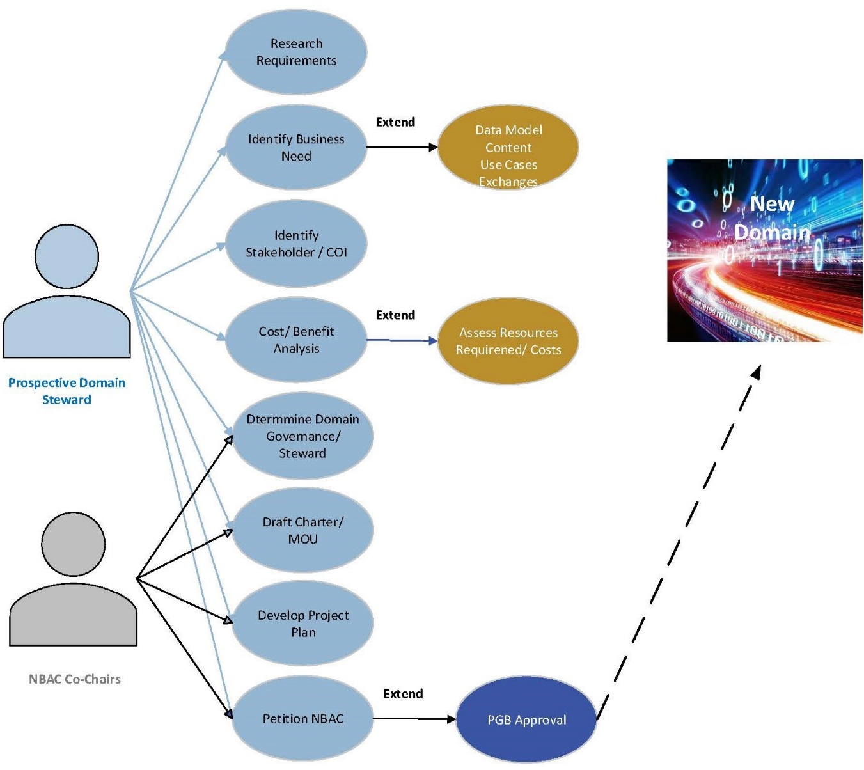
NIEM OPEN Instantiating a Domain
High-level list of Tasks:
Due Diligence
Identify the organizational business need
Overall benefit of establishing a domain
Benefit to NIEM Open Project
Benefit to CoIs
Identify exchange potential use cases and exchange partners
Assess resources required
Conduct cost-benefit assessment and proceed if warranted
Administrative - (Prospective Domain) – identify, propose
Domain name
Sponsoring organization
Steward
Support staff (management & technical)
Points of Contact and mailing list information
Technical - Identify initial model content (Prospective Domain)
Management - Develop Plan of Action and Milestones (POA&M) to support domain standup
Management - Develop draft domain governance document/ charter
Management - Formally propose Domain to NBAC
NBAC votes, (once evaluated and documents shared) simple majority needed to recommend domain to PGB for approval
PGB votes

Slide 46
NIEM OPEN Conservatorship
As domains mature, some domains reach stasis where there is no requirement to create new model content or exchanges. Additionally, there may be circumstances where a domain is suspended, terminated, or otherwise becomes dormant. If a domain is inactive, without a Steward, or dormant for a year, the NBAC may retire the domain and act as conservator for the domain’s content.

Slide 47
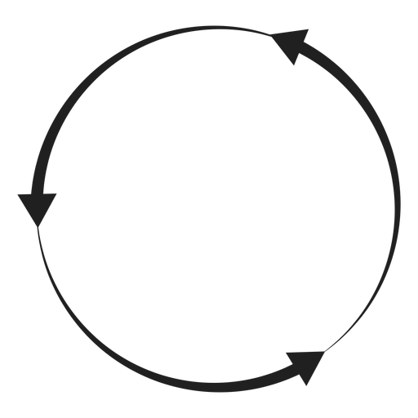
NIEM OPEN Release Process
7
Public
7a
6
International SDO (e.g. ISO, ITU-T, ANSI)
New NIEM
Content/Requirements
1b
2a
3a
New
Content
NBAC
Tiger Team
(As Needed)
NTAC
Tiger Team
(As Needed)
5a
5b
Terms of submission for OS to de jure standards org
Publish/
Announce
Release/
Proj Spec
Domain
Content
Update
1a
2
3
4
5
5c
1
Project
Gov Board
(PBG)
Members
(Review or Consent)
NIEM
Domain
NIEM
Domain
NIEM
Domain
NIEM
Domain
NIEM
Domain
NIEM
Domain
NBAC
NTAC
OASIS
1c
4a
5d
Domain
Out-Of-Cycle Release
2b
3b
Candidate OS Public review
NIEM
Domain
NIEM
Domain
NIEM Release/
Project Spec/
Candidate OS
OASIS
Standard
Release
Maintainer/TSC
NBAC
Maintainer/TSC
NTAC
2c
5e
NIEM
Domains COI
Harmonization & Collaboration
3c
Update/Publish
NIEM
(Model & Code list
Documentation)
Comments
5f

Slide 48
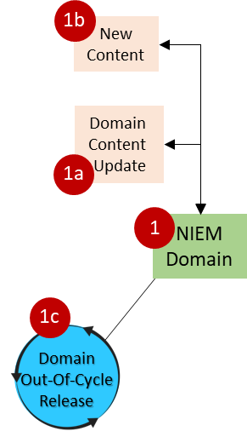
NIEM OPEN Release Process: NIEM Domain
Contribute new / updated requirements / content for their own domain or code tables they are responsible for
Contribute new / updated requirements / content for NIEM in general
Address domain issues submitted by the public
Participate in the Harmonization Working Group or smaller cross-domain working groups
Publish a domain update out-of-cycle
Publish updated content in major and minor releases

Slide 49
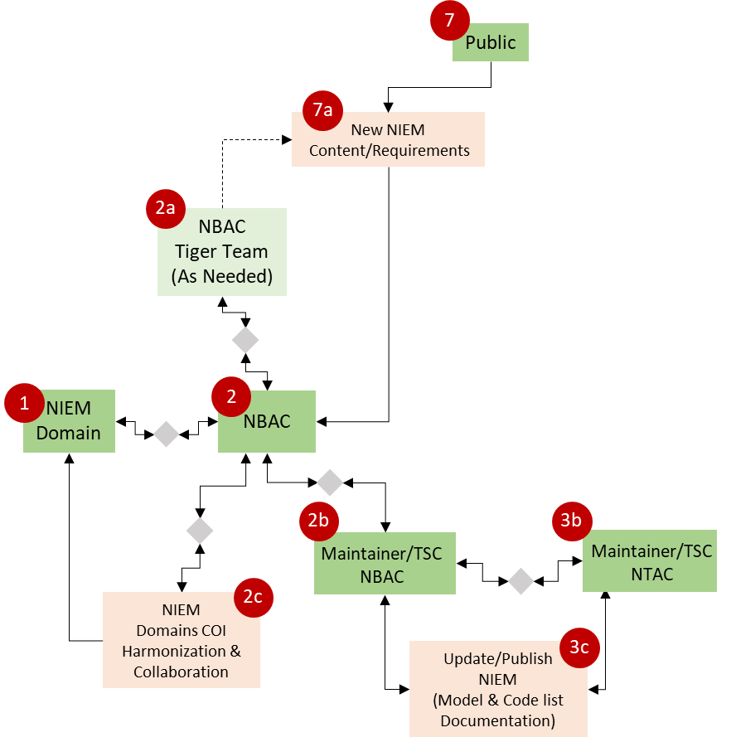
NIEM OPEN Release Process: NBAC TSC
Kick of tiger teams / working groups to address specific topics (e.g. the Harmonization Working Group for major releases)
Review and decide on recommendations from working groups
Review and decide on issues submitted by the public, domains, etc.
Review drafts of a release (alpha, beta, ..)
Vote to approve a release for publication
Submit technical architecture requests / recommendation to the NTAC
Review and provide feedback to technical architecture proposals from the NTAC

Slide 50
NIEM OPEN Release Process: Maintainer
Validates and or triage issues. Can they be addressed in the next release. Is there an interim solution, e.g., Core Supplement? Prep a solution or alternatives for NBAC or tiger team review.
Review domain submissions for QA, to ensure they only modify their own content, check to see if other domains are impacted by the changes, etc.
Review model for harmonization issues, facilitate discussion and review among the Harmonization Working Group and/or NBAC
Prepare, manage and load changes to Core, and other non-domain code tables and other namespaces
Update non-domain code tables
Update the model to apply architecture changes from the NTAC / updated NDR. e.g., new naming rules, updated approach for metadata, etc.
Generate release schemas, documentation, stats, run QA, publish the release to GitHub, update websites and tools, etc.

Slide 51
Roundtable
Mr. Kamran Atri, Mr. Thomas Krul, & Mr. Chet Ensign Facilitators
OASIS OPEN Roles Discussion - Mr. Chet Ensign

Slide 52
break
10 Minutes

Slide 53
Roundtable
Mr. Kamran Atri, Thomas Krul, & Mr. Chet Ensign Facilitators
Contributor License Agreements - Mr. Chet Ensign
2023 Work Plan Discussion – Mr. Kamran Atri & Mr. Thomas Krul

Slide 54


Questions & Answers/ Actions ITEMS
Mr. Kamran Atri & Mr. Thomas Krul Facilitators

Slide 55
19 AUGUST Agenda

Slide 56
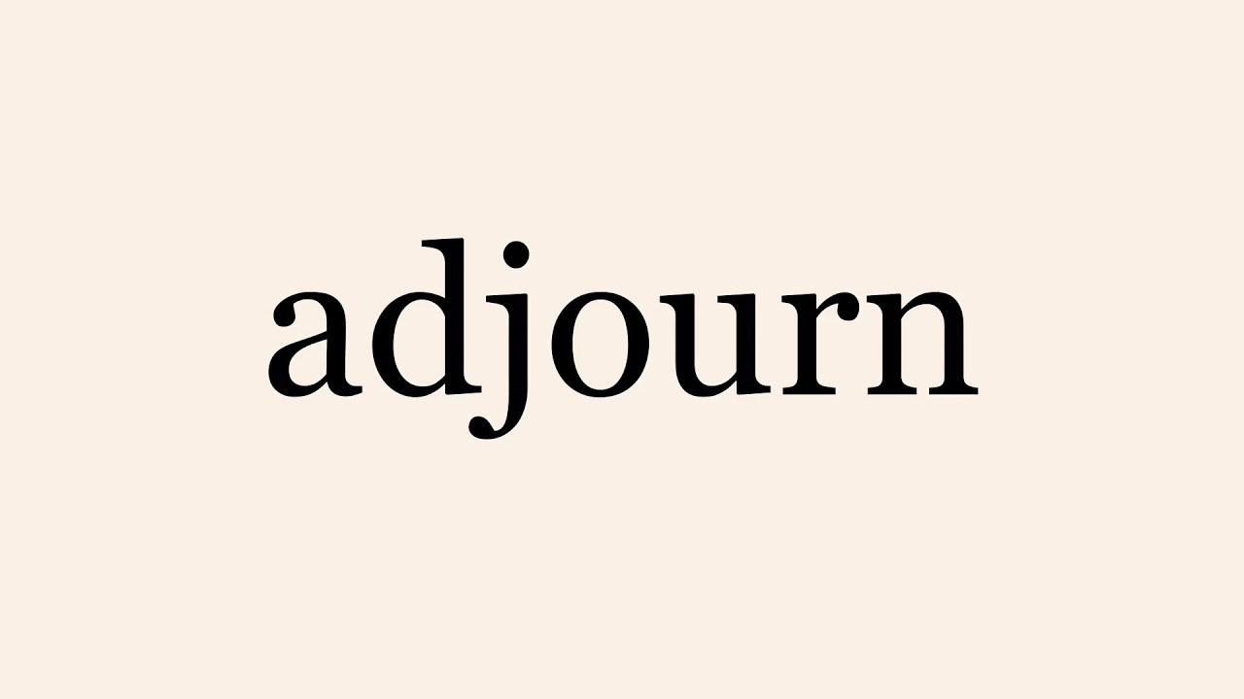

Slide 57
(NBAC Annual Meeting)
19 August 2022
Kamran Atri
Thomas Krul

Slide 58
Welcome to the 2022 Nbac Annual meeting
Welcome
Admin
GTRI Facilities
MS TEAMS
Meeting Etiquette
Agenda
Opening Remarks

Slide 59
MS TEamS
Microsoft Teams meeting
Join on your computer or mobile app
Click here to join the meeting
https://dod.teams.microsoft.us/l/meetup-join/19%3adod%3ameeting_aaa3877ce06b43c4846d2ba47d336309%40thread.v2/0?context=%7b%22Tid%22%3a%22102d0191-eeae-4761-b1cb-1a83e86ef445%22%2c%22Oid%22%3a%2209533073-ba80-4ec6-aa29-c3f724b8aa56%22%7d
Or call in (audio only)
+1 410-874-6749,,579640852# United States, Baltimore
Phone Conference ID: 579 640 852# Find a local number | Reset PIN
Document Repo: https://github.com/NIEM/NIEM-Annual-Meetings/tree/master/2022 < Caution-https://github.com/NIEM/NIEM-Annual-Meetings/tree/master/2022

Slide 60
Making the most of our session

Slide 61
19 AUGUST Agenda

Slide 62
Opening remarks
Recap of day before
Open mic for all NIEM Domains – Issues, Opportunities, Challenges, Strength
All about working session and roundtable discussion

Slide 63
Roundtable – Domain focus
Mr. Kamran Atri, Mr. Thomas Krul, & Mr. Chet Ensign Facilitators
Domain Issues – Mr. Kamran Atri/ Mr. Thomas Krul & NIEM OPEN Domains
Compare & Contrast PGB vs TSC (NBAC) - Mr. Kamran Atri/ Mr. Chet Ensign

Slide 64
Roundtable – Domain focus
Mr. Kamran Atri, Mr. Thomas Krul, & Mr. Chet Ensign Facilitators
Domain Leadership Under NIEM OPEN – All
Topics
– Model Content Introduction into OASIS – Mr. Kamran Atri
Domain Charters - Mr. Kamran Atri, Mr. Thomas Krul
CLAs – Mr. Chet Ensign
Sponsorship - Mr. Kamran Atri, Mr. Thomas Krul, & Mr. Chet Ensign Facilitators

Slide 65
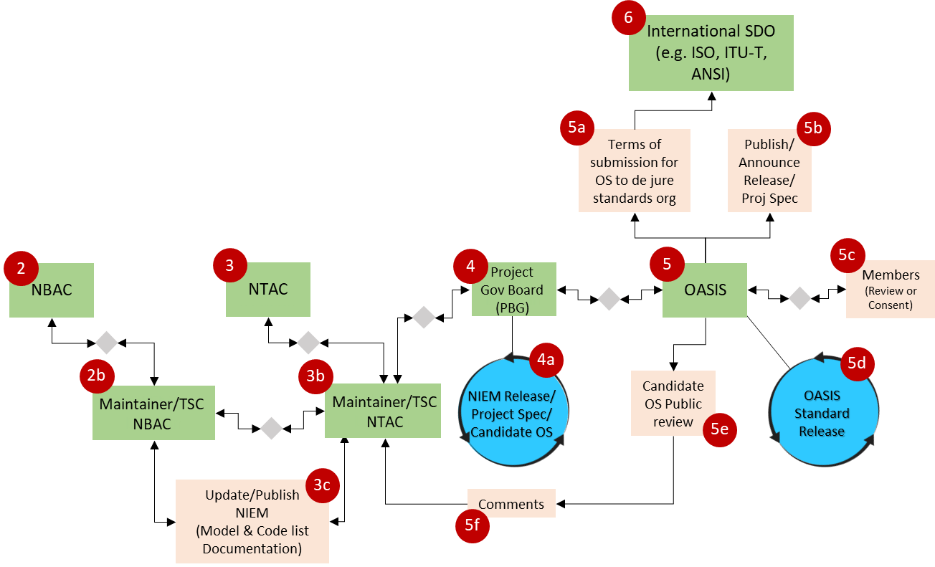
Model Content Intro into OASIS
Our Phased recommendation for promoting existing NIEM content into OASIS as an approved Standard
Phase One:
Core content
Phase Two:
Domain content

Slide 66
Model Content Intro into OASIS
Properties as of 5.1 Release

Slide 67
Model Content Intro into OASIS
Types as of 5.1 Release

Slide 68
Model Content Intro into OASIS
Codes as of 5.1 Release

Slide 69
break
10 Minutes

Slide 70
Roundtable – Domain focus
Mr. Kamran Atri, Mr. Thomas Krul, & Mr. Chet Ensign Facilitators
Domain Updates - Domains
Dormant Domains Discussion – Mr. Kamran Atri & Mr. Thomas Krul
Conservatorship of NIEM Equities

Slide 71
Questions & Answers/ Actions ITEMS
Mr. Kamran Atri & Mr. Thomas Krul Facilitators

